Slide 1
A&F Dashboard
Delivery and final steps
Performance Analytics and Business Dashboards OC Brazil, Advisors Client Services

Slide 2
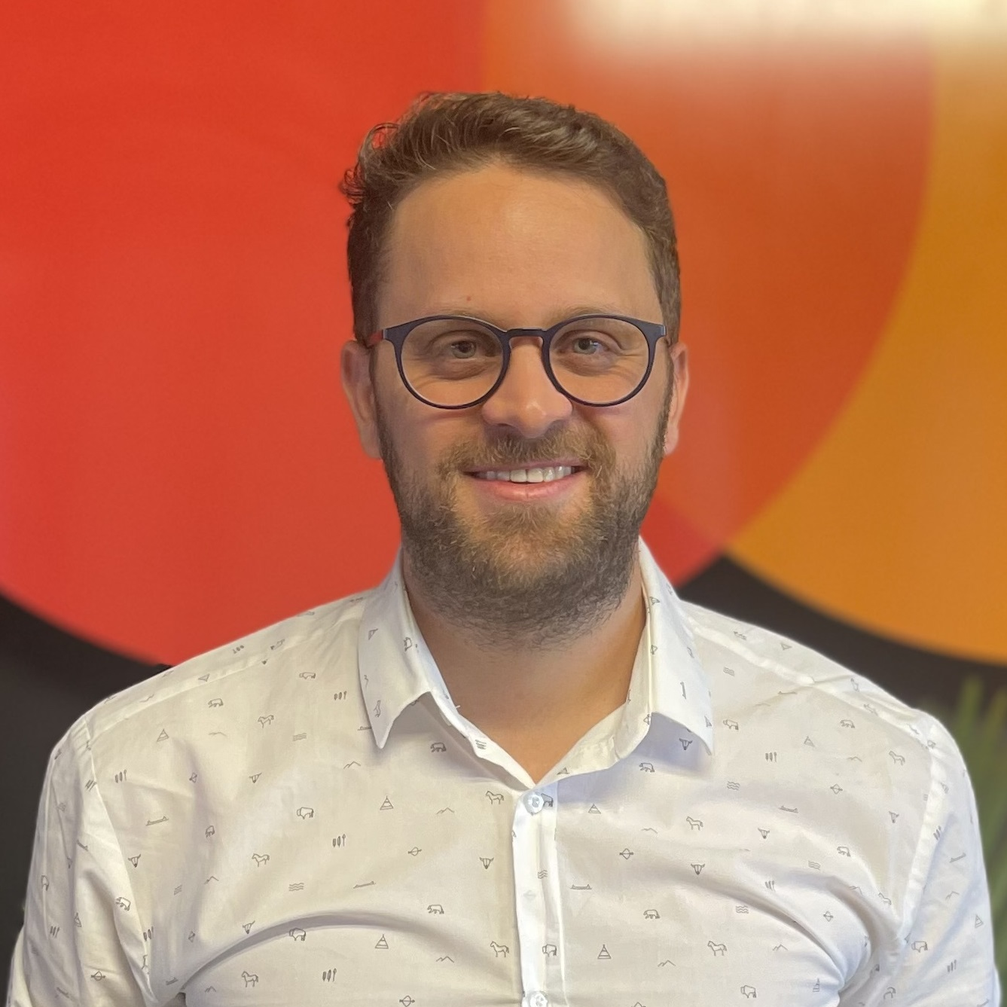


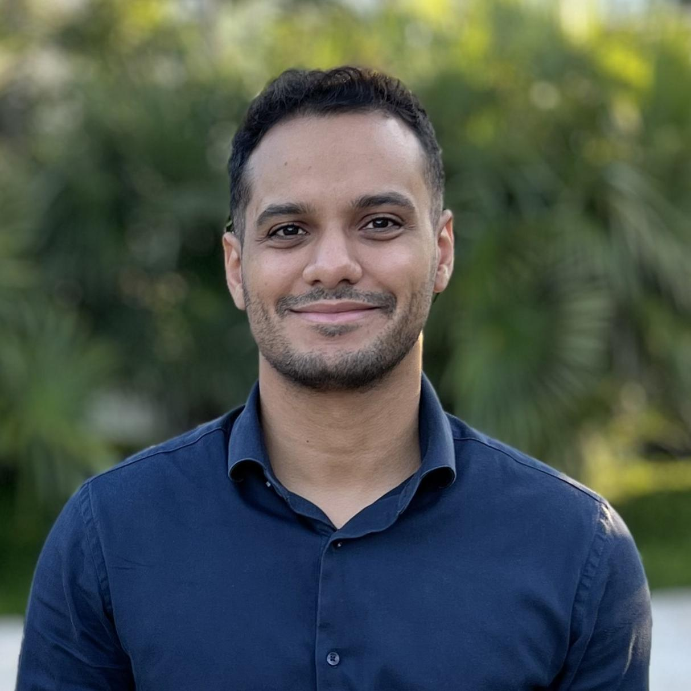






The dashboard was developed under Q1’26 with investment code hours provided by the Product team to create a more scalable solution for LAC market
TO DISCUSS
Team engagement
Progress
Development team
Data visualization
Issuer
100%
+ previous collaborators (Diego Pesce, Pedro Chagas)
Acquirer
80%
Yuri
de Sousa
Francisco
do Nascimento
Mateus
Martins
Emanuel
Dias
Dashboard is published for internal tests, and it will be rolled out in new A&F projects soon.
Support team
Data extraction of last 14 months (jan25 to feb26)
Brazil
100%
Nathalia
Luz
Mateus
Guedes
Geannina
Gomez
Rafael
Sobral
LAC
80%
Data for LAC is already extracted, missing only the upload on the dashboard
There are still remaining hours from the investment code to polish last details (until April 17th)
Mattia
Valsangiacomo
Roberto
Zuñiga

Slide 3

The new version presents ready-to-use peer groups and new breakdowns
TO DISCUSS
Features
Pre-defined peer groups
Raw and Clean (without retrials) authorization rate
Fraud rate
Declined reason code share
Count and amount transacted
Delivery-ready format
Breakdowns
Consumer/Corporate
Credit/Debit
CP/CNP
Dom/Cross-border
Input mode
Ticket size/range
Time period of the day
Wallet type
Product
Tokenized/card on file
Authentication (3Ds)
MCC
Super industry
Acquirer (for issuer view)
What is not included so far
Merchant
CVS
MAC code
DI score range
Stand-in

Slide 4
The current dashboard will be used in ACS projects as an efficiency improvement tool and also as a standalone product
TO DISCUSS
Use cases
Benefits for ACS
A&F Report as a service
Monthly delivery of A&F performance reports for Acquirers and Issuers
New revenue flows
A&F Dashboard
Efficiency/margin gain on A&F vanilla/marketwide projects
Effort decrease in the most critical parts of an A&F project (data extraction and peer grouping)
Existing revenue
Higher margin or possibility to invest more time in detailed analysis

Slide 5

The dashboard is currently published for demo purposes, but it will be moved to a restricted area so access control can be made
TO DISCUSS

Slide 6
The dashboard is ready to be tested in ACS Projects scenarios, and options are already mapped
TO DISCUSS
Next steps
Possible improvements
Possible test roll-out in future projects and opportunities (Sisprime and Banco do Brasil)
Maintenance costs will be absorved by the ongoing A&F projects that uses the tool
Monthly update
Addition of players or peer groups
New breakdowns and features
Future collaboration with LAC Team (Geannina Gomez) to scale even more to LAC specific needs
Peer grouping for LAC (custom and/or pre-defined)
New debit breakdowns
Future improvements mapped in the test phase (Sisprime and Banco do Brasil)

